Slide 1




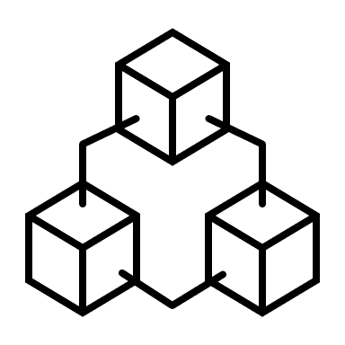










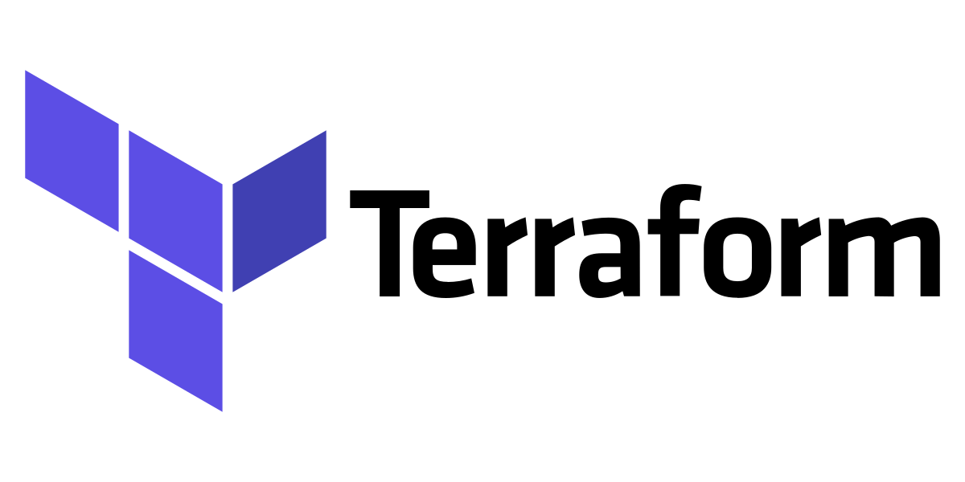
Illustrative Reference Architecture
Data Sources
Ingestion Services
Data Storage
Data Enrichment
Serving
Consumption
R&D
Data Ingestion
Unity Catalog
Amazon S3
Aggregates
Facts
Self- Service Analysis
Supply chain
Streaming
Raw Data Layer (L0)
KPI’s
Dimensions
Cloud Storage
Data Marketplace
Quality
Curated Data Layer (L1)
Power users
Batch
Virtual Knowledge Graph
Customer
Data Processing
Insights
API Integration
Corporate
Change Data
Applications
Data Integration & Data Quality
Patterns
Scalable
Compute
SQL
Collibra
Finance
Data Science
& Analytics
Manual
Ingestion Framework
Common Engineering Functions
Clusters
Workflows
Delta Live
Data
Governance
Quality
Metadata
Catalog
Lineage
Unity Catalog
DevOps, Deployment & Security
IAM
Code Repository
Continuous Integration/
Deployment
Monitoring
Logging
Deployment Manager
Cloud Console

Slide 2

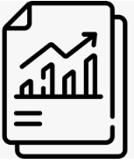
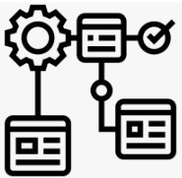




Data Modernization Toolkit
Tiger Data modernization Toolkit helps discover the legacy system, analyse complexity & data volume, helps migrate SQL code and migrate data
Source Systems
Tiger Data Modernization Toolkit
Target
The discoverer engine extracts the inventory information, definitions & volumetric information from source systems, analyses the complexity and generates lineage
The SQL translator engine migrates the table definitions, views, functions, stored procedures etc using cloud native tools
The Data migrator engine migrates the data from source system to target system using the cloud native tools
Migration summary report provides the inventory summary, migrated SQL and data
4
1
Discoverer
Inventory Extractor
Complexity Analyzer
Migration Summary
Oracle
Data Volume Analyzer
SQL Server
Metadata
Definition Extractor
Lineage Generator
Data Lineage
Netezza
Teradata
2
Metadata
SQL Translator
Migrated SQL
3
Data
Data Migrator
Migrated Data

Slide 3








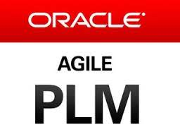



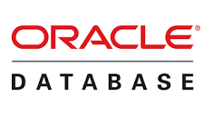













Technical Architecture
Data Sources
Data Lake
Consumption Layer
Batch data transfer using Informatica and available GCP services
Bronze Layer
Silver Layer
Gold Layer
Power users
Google Cloud Storage
Google Cloud Storage
Google Cloud Storage
OAC reports
Standardized Source Tables
Processed Tables
Dashboard Owner
Source Tables – Golden Copy
Data Professional
Tables | Reports
Landing Layer
Presentation Layer
Power BI reports
Key Stakeholders
Hive Tables
Historical Data
Cloud
Dataproc
Google Cloud Storage
Google BigQuery
gsutil
Google Cloud
Composer
Workflow Orchestration
Offline
Consumers
SFTP Servers
Google Cloud
Build Triggers
CI/CD Pipeline
Common Reusable Programs
User Personas

